Slide 1
Deep Learning with Tensorflow

Slide 2
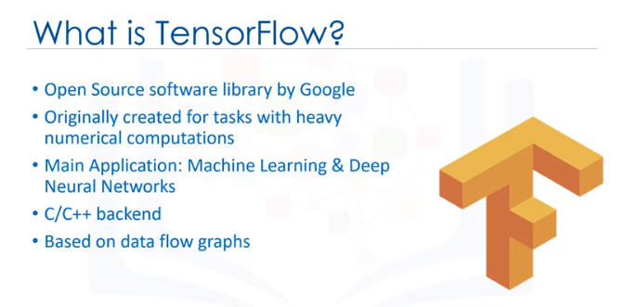
What is Tensorflow

Slide 3
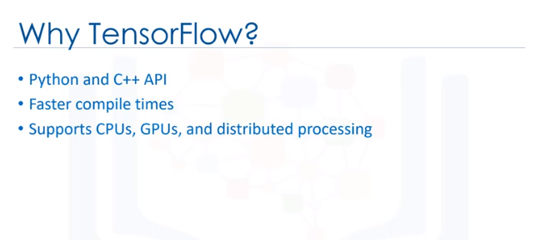

Slide 4
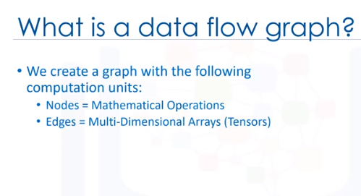
A Data Flow Graph is a representation of data dependencies between operations.

Slide 5
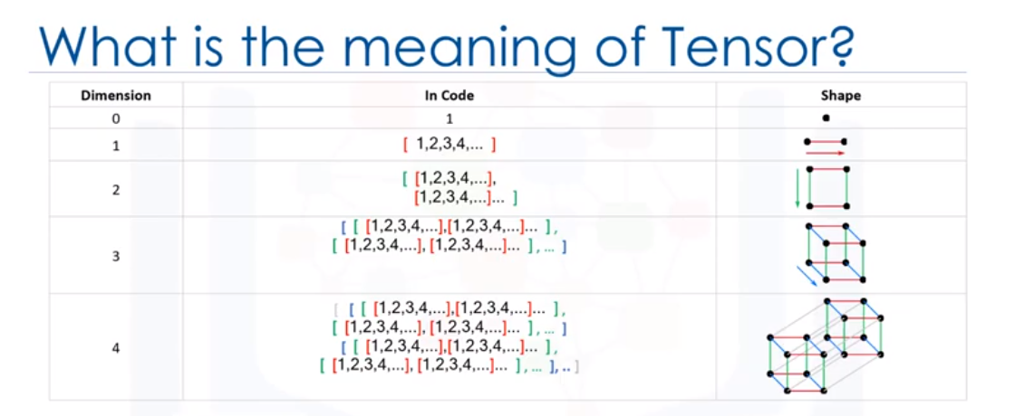

Slide 6
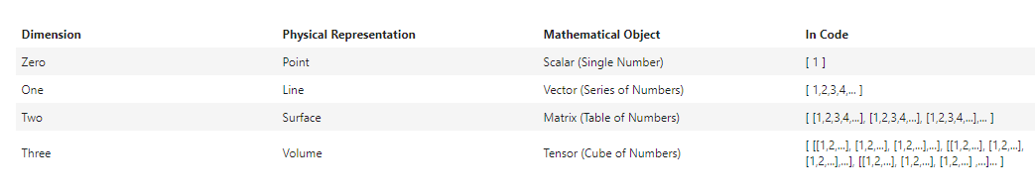
What it the meaning of Tensor?
In TensorFlow all data is passed between operations in a computation graph, and these are passed in the form of Tensors, hence the name of TensorFlow.

Slide 7
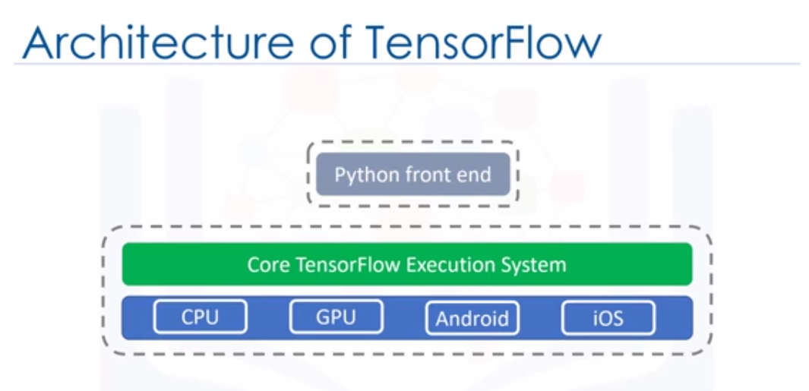

Slide 8
Linear regression- 1
Defining a linear regression in simple terms, is the approximation of a linear model used to describe the relationship between two or more variables.
When more than one independent variable is present the process is called multiple linear regression.
When multiple dependent variables are predicted the process is known as multivariate linear regression.

Slide 9
Linear regression- 2
In a simple linear regression there are two variables, the dependent variable, which can be seen as the "state" or "final goal" that we study and try to predict, and the independent variables, also known as explanatory variables, which can be seen as the "causes" of the "states“
The equation of a simple linear model is : Y = a X + b
Where Y is the dependent variable and X is the independent variable, and a and b being the parameters we adjust. a is known as "slope" or "gradient" and b is the "intercept". You can interpret this equation as Y being a function of X, or Y being dependent on X

Slide 10
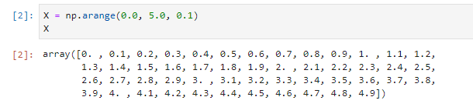
Define Independent variable

Slide 11
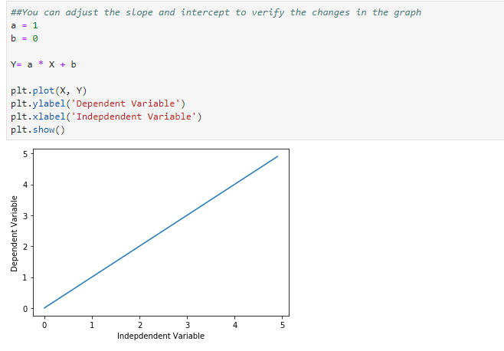

Slide 12
The gradient Descent optimizer takes in parameter: learning rate, which corresponds to the speed with which the optimizer should learn;
There are pros and cons for increasing the learning-rate parameter, with a high learning rate the training model converges quickly, but there is a risk that a high learning rate causes instability and the model will not converge.
On the other hand decreasing the learning rate might reduce the convergence speed, but it would increase the chance of converging to a solution. You should note that the solution might not be a global optimal solution as there is a chance that the optimizer will get stuck in a local optimal solution.

Slide 13
What is deep learning ?
Deep Learning is a series of supervised, semi-supervised and unsupervised methods that try to solve some machine learning problems using deep neural networks.
A deep neural network is a neural network which often has more than two layers, and uses specific mathematical modeling in each layer to process data.
Generally speaking, these networks are trying to automatically extract feature sets from the data, and this is why, they are mostly used in data types where the feature selection process is difficult, such as when analyzing unstructured datasets, such as image data, videos, sound and text.

Slide 14
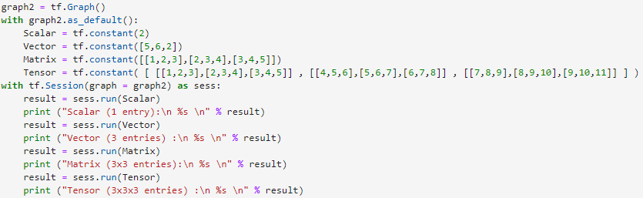
Defining multidimensional arrays using TensorFlow

Slide 15
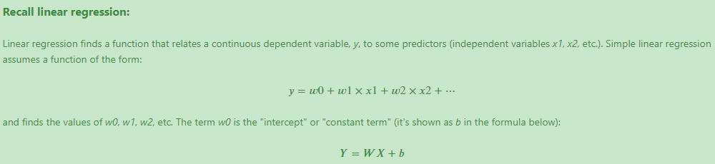
Linear Regression
Suited for estimating continuous values (e.g. estimating house price)

Slide 16
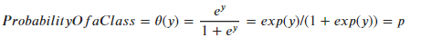
Logistic Regression
Logistic Regression is a variation of Linear Regression, useful when the observed dependent variable, y, is categorical.
It produces a formula that predicts the probability of the class label as a function of the independent variables.
It is actually a probabilistic classification mode
Logistic regression fits a special s-shaped curve by taking the linear regression and transforming the numeric estimate into a probability with the following function:

Slide 17
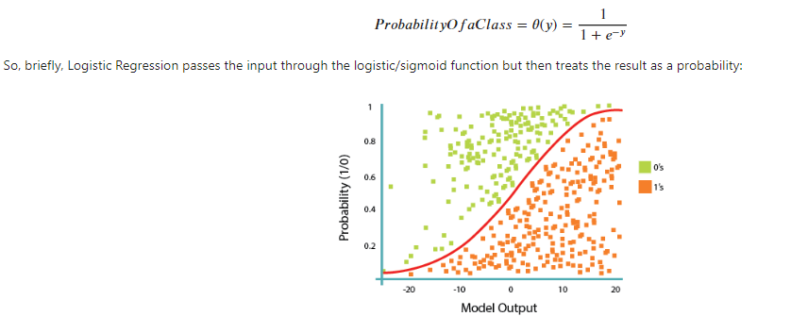
What tell us our model is bad?
The Cost or Loss of the model, so what we want is to minimize that.

Slide 18
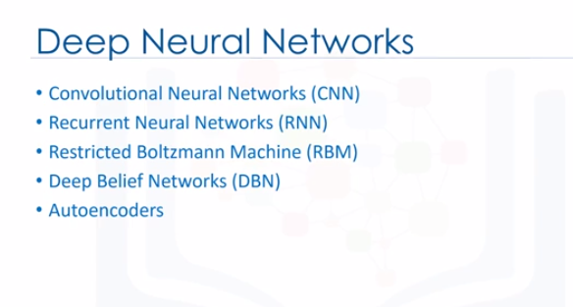

Slide 19
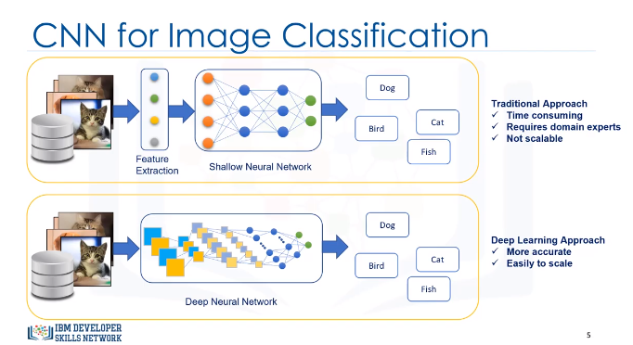
Convolutional Neural Network – 1
Helps us to do task such as image classification
Is a deep learning approach that learns from samples

Slide 20
Convolutional Neural Network – 2
CNNs achieve this type of automatic feature selection and classification through multiple specific layers of sophisticated mathematical operations.

Slide 21
Convolutional Neural Network – 2 (applications of CNNs)
Image Recognition/Classification (skin cancer, Dog or cat?,…)
Object Detection (self driving cars, coloring black and white images, creating art images…)

Slide 22
Recurrent Neural Network (RNN)
RNN is a type of deep learning approach that tries to solve the problem of modeling sequential data.
For example, a stock market price is a sequential type of data because the price of any given stock in tomorrow’s market, to a great extent, depends on its price today. As such, predicting the stock price tomorrow, is something that RNNs can be used for. We simply need to feed the network with the sequential data, it then maintains the context of the data and thus, learns the patterns within the data.

Slide 23
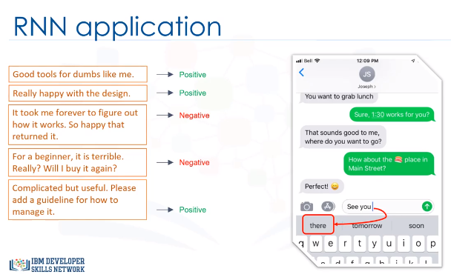

Slide 24
Restricted Boltzmann Machines (RBMs) -1
RBMs are used to find the patterns in data in an unsupervised manner.
They are shallow neural nets that learn to reconstruct data by themselves.
They are very important models, because they can automatically extract features from a given input, without the need to label them.
They are significant as building blocks of other networks, such as Deep Belief Networks.

Slide 25
Restricted Boltzmann Machines (RBMs) -2
Essentially, RBMs are useful for unsupervised tasks such as:
Feature extraction,
Dimensionality reduction,
Pattern recognition,
Recommender systems,
Handling missing values,
And topic modeling.

Slide 26
Deep Belief Network (DBN)
DBN is a network that was invented to solve an old problem in traditional artificial neural network. Which problem?
The back-propagation problem, that can often cause “local minima” or “ vanishing gradients” issues in the learning process.
A DBN is Built to solve this by the stacking of multiple RBMs.

Slide 27
Deep Belief Network (DBN)- Applications
Image recognition
We don’t need a big set of labeled data to train a Deep Belief Network, a small set is fine because feature extraction is unsupervised by a stack of RBMs.

Slide 28
Autoencoder
Were invented to address the issue of extracting desirable.
Autoencoders try to recreate a given input, but do so with a slightly different network architecture and learning method.
Autoencoders take a set of unlabeled inputs, encodes them into short codes, and then uses those to reconstruct the original image, while extracting the most valuable information from the data.

Slide 29
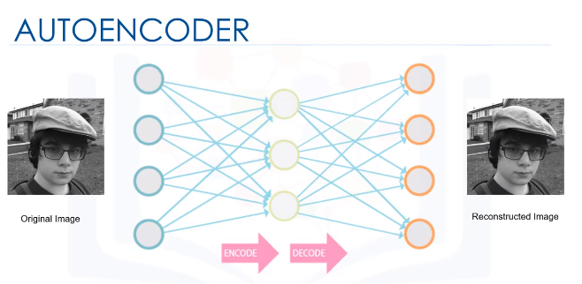

Slide 30
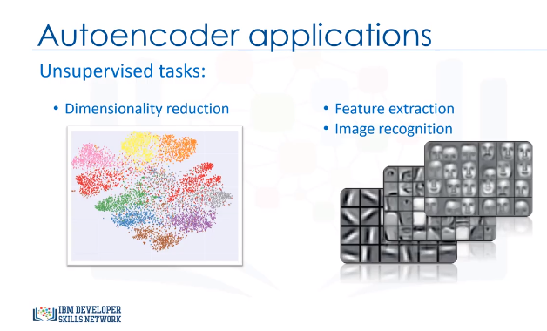

Slide 31
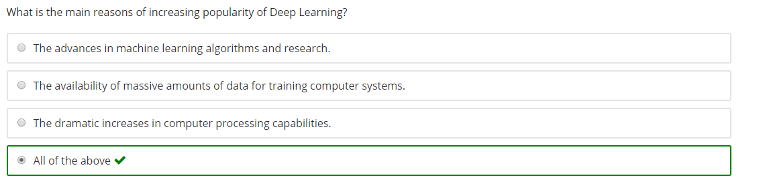
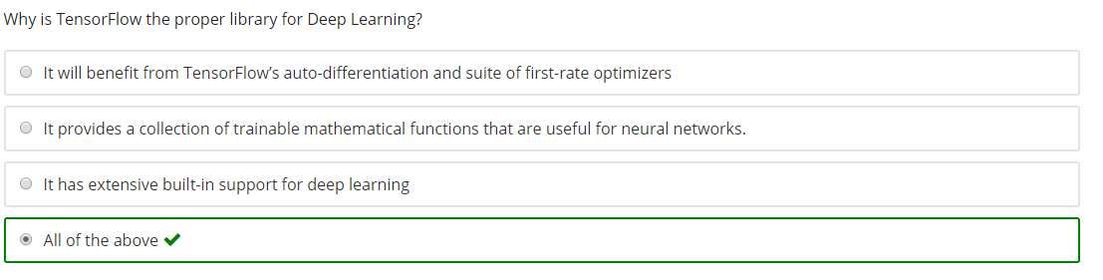

Slide 32
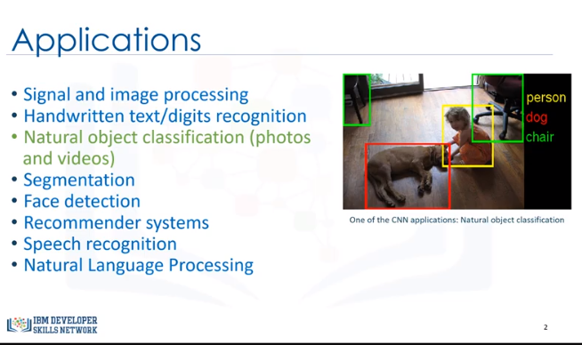
Convolutional Neural Network

Slide 33
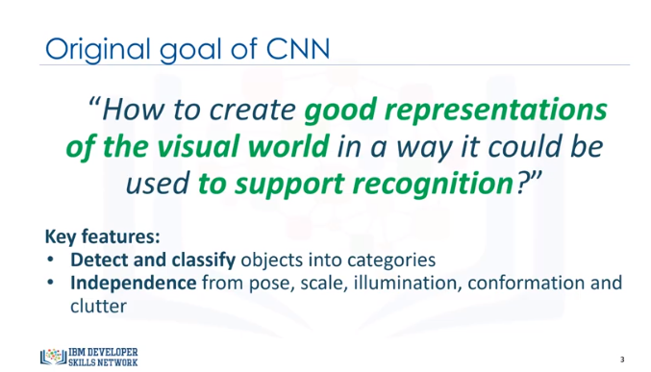

Slide 34
CNNs for Classification
One of the important steps in the modeling for classification with Shallow Neural Networks, is the feature extraction step.
These chosen features could simply be the color, object edges, pixel location, or countless other features that could be extracted from the images.
The process of selecting the best features is hard
Extending the features to other types of images is not possible

Slide 35
Convolutional neural networks (or CNNs) try to solve this problem by using more hidden layers, and also with more specific layers. So, when using CNN, instead of you choosing image features, to classify dogs vs. cats, for instance, CNNs can automatically find those features and classify the images .

Slide 36
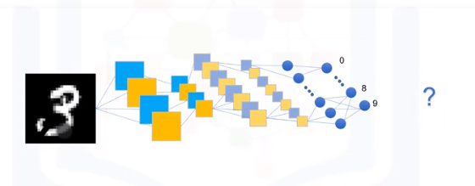
Build a digit recognition system using CNN

Slide 37
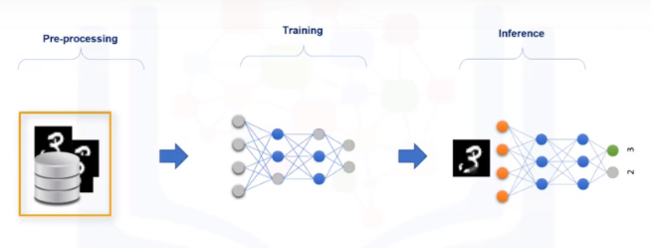
Training and Inference
Pre-processing: convert the images to a readable and proper format for the network

Slide 38
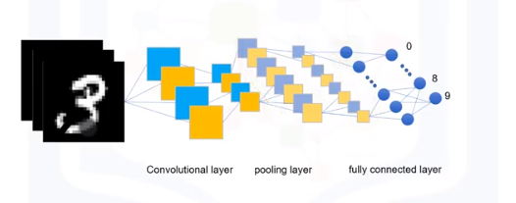
Deep Neural Network
A deep neural network has multiple convolutional layers, pooling layers, as well as fully connected layers.
The convolutional layer applies a convolution operation to the input, and passes the result to the next layer.
The pooling layer combines the outputs of a cluster of neurons in the previous layer into a single neuron in the next layer.

Slide 39
Understanding convolution - 1
The main purpose of the Convolutional layer is to detect different patterns or features from an input image, for example, its edges.
what really happens mathematically when we apply a filter or kernel on an image? This brings us to the Convolution process.
Convolution is a function that can detect edges, orientations, and small patterns in an image.
The convolution operation can be seen as a mathematical function.

Slide 40
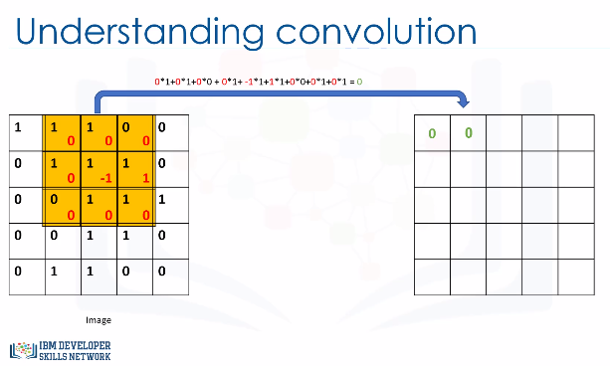
Understanding convolution - 2
The Convolution Function is a simple matrix multiplication

Slide 41
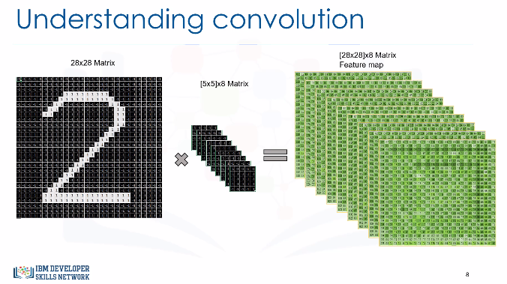
Understanding convolution - 3
Now, let’s consider a hand-written digit that we want to recognize.
We can apply a kernel to it. It is, in fact, the sum of "element-wise multiplication"
of the kernel matrix and the image matrix, as shown on the previous slide.
So, we can show the result as convolving a kernel on the image.
Applying multiple kernels on one image will result in multiple convolved images.
Now you can understand that leveraging different kernels allows us to find different patterns in an image, such as edges, curves, and so on.
The output of the convolution process is called a 'feature map'.

Slide 42
Understanding convolution - 4
1- How do I choose or initialize the proper kernels?
You initialize the kernels with random values, and during the training phase, the values will be updated with optimum values, in such a way that the digit is recognized.
We can interpret this layer to traditional neural network terminology.
The input image can be considered as a matrix that we feed into the neural network through input nodes.
For example, in this case, the input layer of the network has 28-by-28 nodes. The output of the co-evolution process, are 8 of [28-by-28] neurons. We can assume those as hidden nodes.

Slide 43
Understanding convolution - 4
2- What are the weights between the input and hidden nodes?
The 8 kernels, which are 5-by-5. Now we need to make a decision as to whether each hidden neuron should be “fired” or not.
So, we have to add “activation functions” to the neurons.
We use ReLu (which is short for rectified linear unit) as the activation function on top of nodes in the Convolution layer.

Slide 44
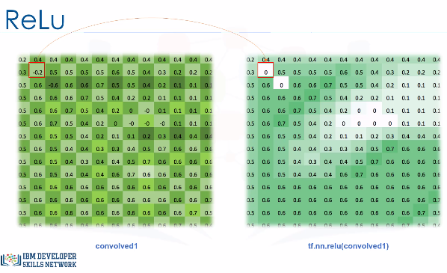
Understanding convolution - 5
3- What is ReLu?
It’s a nonlinear activation function, which is used to increase the nonlinear properties of the decision function.
4- How can we apply it on Convolutional layer?
We just go through all outputs of the Convolution layer, covolved1, and wherever a negative number occurs, we swap it out for a 0. This is called the ReLu activation Function.

Slide 45
Understanding convolution - 6
Now, we have gone one step further. In this step, we have to down-sample the output images from the ReLu function, to reduce the dimensionality of the activate neurons.
So, we use another layer, which is called Max-Pooling.
“Max-Pooling” is an operation that finds the maximum values and simplifies the inputs. In other words, it reduces the number of parameters within the model.
In a sense, it turns the low level data into higher level information.

Slide 46
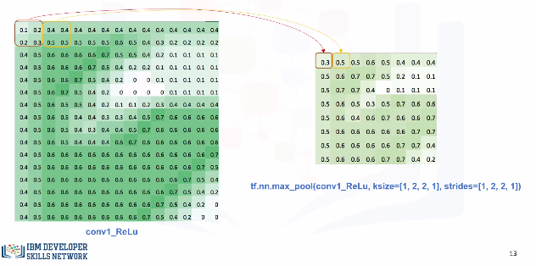
Understanding convolution - 7
For example, we can select a window of size of 2-by-2, and then select the maximum value for this matrix. That is, if the image is a 2-by-2 matrix, it would result in one output
pixel.
Also, in this step, we can define Strides.
A Stride dictates the sliding behavior of the Max-Pooling.
For example, if we select stride=2, the window will move 2 pixels every time, thus not overlapping.
Now should have our output matrices, but with lower dimensions, for example 14-by-14.

Slide 47
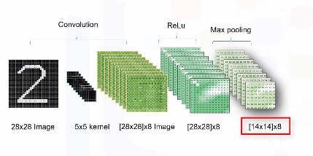
Understanding convolution - 8
Now should have our output matrices, but with lower dimensions, for example 14-by-14.
The next layer is the Fully-Connected layer.

Slide 48
Understanding convolution - 9
Fully-Connected layers take the high-level filtered images from the previous layer, that is, all 8 matrices in our case, and convert them into a vector.
First, each previous layer matrix will be converted to a one-dimensional vector.
Then, it will be Fully-Connected to the next hidden layer, which usually has a low number of hidden units.
We call it Fully-Connected because each node from the previous layer is connected to all the nodes of this layer. It is connected through a weight matrix.
We can use ReLu activation again here.

Slide 49
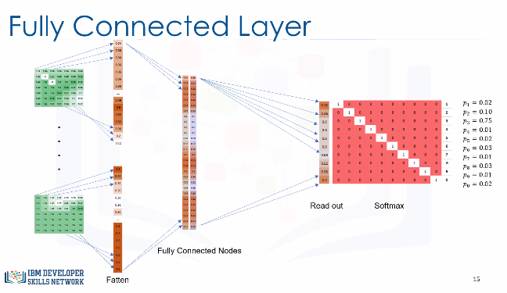

Slide 50
Understanding convolution - 10
And finally, we use Softmax to find the class of each digit.
Softmax is an activation function that is normally used in classification problems. It generates the probabilities for the output.
For example, our model will not be 100% sure that one digit is the number 3; instead, the answer will be a distribution of probabilities where, if the model is right, the 3 will be assigned the larger probability. That is, Softmax can output a multiclass categorical probability distribution.

Slide 51
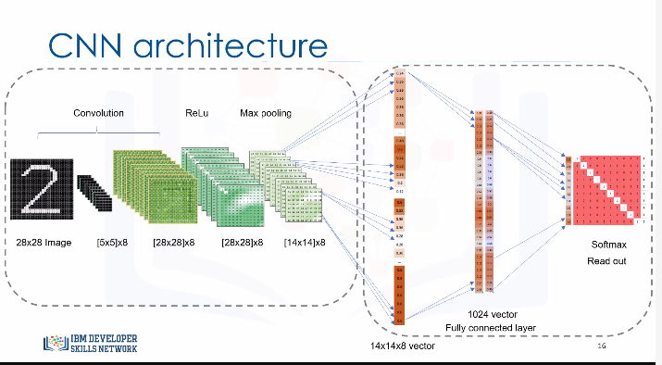

Slide 52
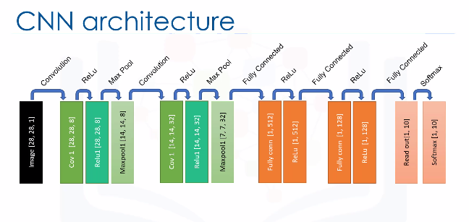
Understanding convolution - 11
Note the effect of each single Conv, ReLu and Max-Pool operations pass through the image: it reduces height and width of the individual image, and then it increases the depth of the images.
For example, the output of the first convolutional layer is an image of depth 8, and the output of the second layer is an image of depth 32. This is very important, because using multiple layers, CNN will be able to break down the complex patterns into a series of simpler patterns.

Slide 53
Understanding convolution - 12
A CNN is a type of feed-forward neural network, consisting of multiple layers of neurons.
Each neuron in a layer receives some input, processes it, and optionally follows it with a non-linear output using an activation function.
So, what is the network going to learn through the training process? Well, it learns the connections between the layers. These are the learnable weights and biases matrices.
In fact, the whole network is about a series of dot products between the weight matrices and the input matrix.
This means we must first initialize the weights of the network randomly.
Then, we will keep feeding the network with a big dataset of images.
We then check the output of the network and depending on how far the output is from the expected one, we change/update the weights. We keep repeating this process until it reaches a high accuracy of prediction.

Slide 54
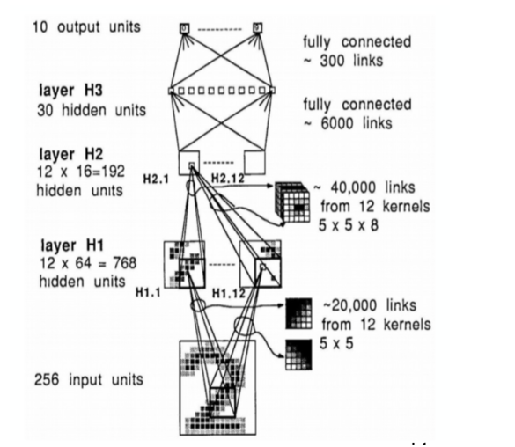
Understanding convolution - 13

Slide 55
Understanding convolution - 14 - Feature Learning
Feature engineering is the process of extracting useful patterns from input data that will help the prediction model to understand better the real nature of the problem. A good feature learning will present patterns in a way that significantly increase the accuracy and performance of the applied machine learning algorithms in a way that would otherwise be impossible or too expensive by just machine learning itself.
Feature learning algorithms finds the common patterns that are important to distinguish between the wanted classes and extract them automatically. After this process, they are ready to be used in a classification or regression problem.
The great advantage of CNNs is that they are uncommonly good at finding features in images that grow after each level, resulting in high-level features in the end. The final layers (can be one or more) use all these generated features for classification or regression.

Slide 56
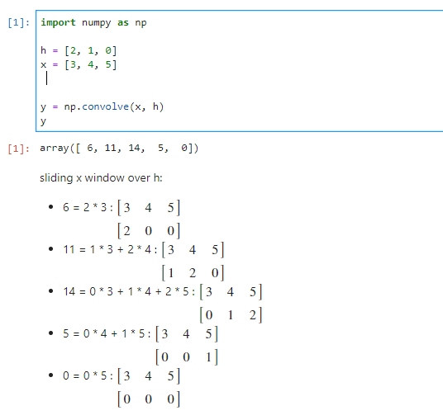
Understanding convolution - 15 - Convolution: 1D operation with Python (Numpy/Scipy)

Slide 57
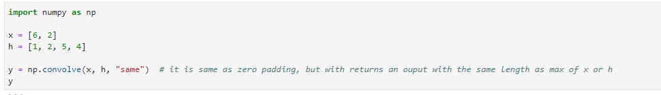
Understanding convolution - 16
There are three methods to apply kernel on the matrix, with padding (full), with padding(same) and without padding(valid):
Visually understanding the operation with padding (same)

Slide 58
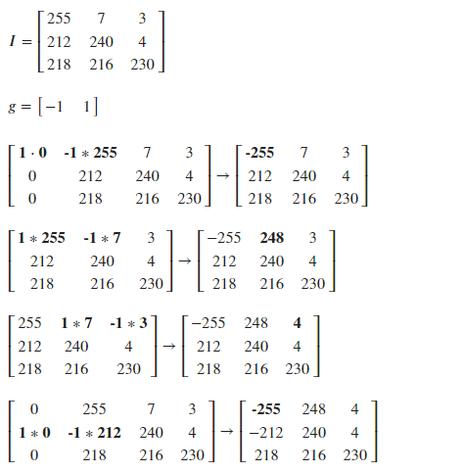
Understanding convolution - 17 - Convolution: 2D operation with Python (Numpy/Scipy)
Below we will apply the equation to an image represented by a 3x3 matrix according to the function g = (-1 1)

Slide 59
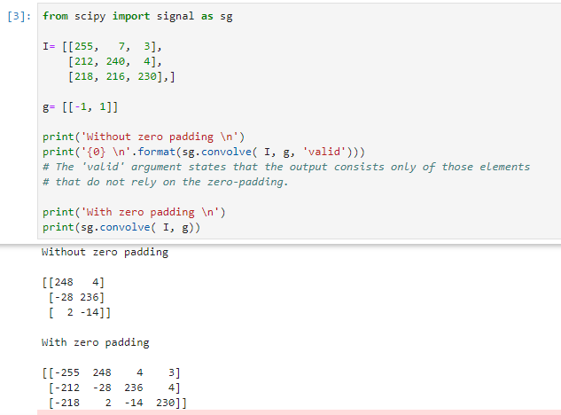

Slide 60
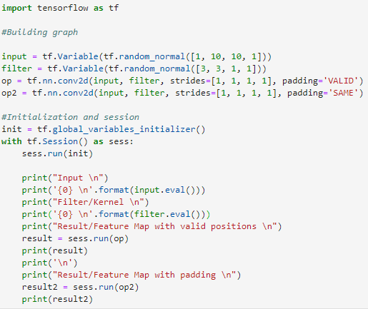
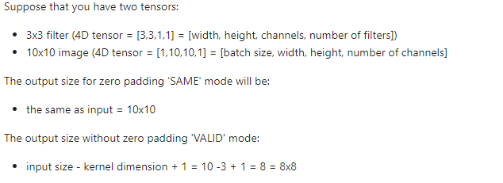
Understanding convolution - 18 – Coding with tensorflow

Slide 61
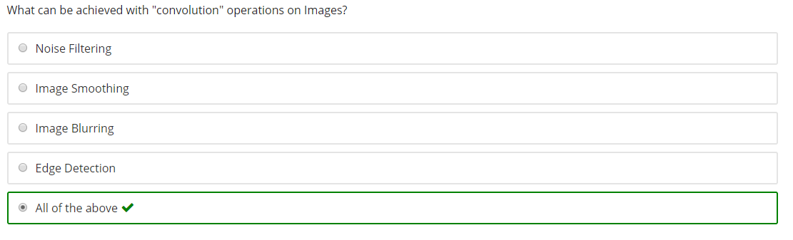
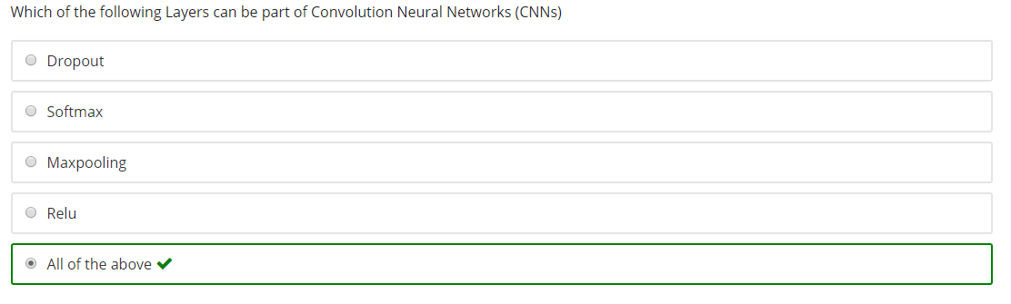

Slide 62
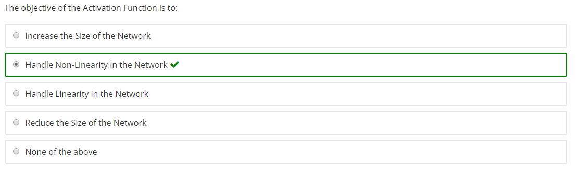

Slide 63
Cost Function
It is a function that is used to minimize the difference between the right answers (labels) and estimated outputs by our Network.
How to improve our model?
Several options as follow:
Regularization of Neural Networks using DropConnect
Multi-column Deep Neural Networks for Image Classification
APAC: Augmented Pattern Classification with Neural Networks
Simple Deep Neural Network with Dropout

Slide 64
Sequential Data
Whenever the points in a dataset are dependent on the other points, the data is said to be sequential.
A Recurrent Neural Network has a mechanism that can handle a sequential dataset.

Slide 65
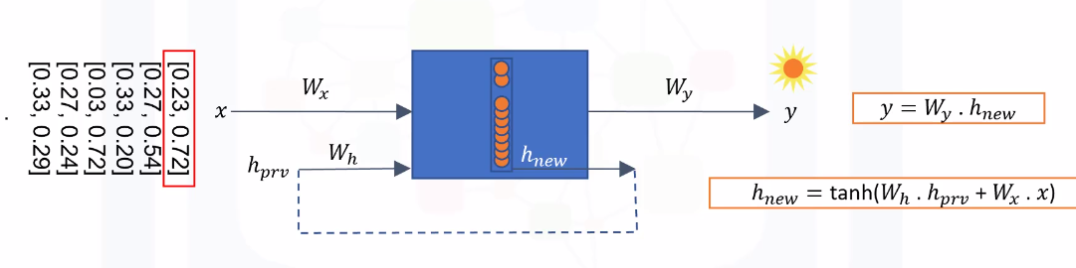
Recurrent Neural Network- 1
RNN is a great tool for modeling sequential data
The RNN is able to remember the analysis that was done up to a given point by maintaining a state. You can think of the “state” as the “memory” of RNN, which captures information about what’s been previously calculated.
This “state” recurs back into the net with each new input, which is where the network gets its name.

Slide 66
Recurrent Neural Network- 3
Recurrent Neural Networks are Deep Learning models with simple structures and a feedback mechanism built-in, or in different words, the output of a layer is added to the next input and fed back to the same layer.
However, this model has some problems. It's very expensive to maintain the state for a large amount of units, even more so over a long amount of time.
Additionally, Recurrent Networks are very sensitive to changes in their parameters.
As such, they are prone to different problems with their Gradient Descent optimizer -- they either grow exponentially (Exploding Gradient) or drop down to near zero and stabilize (Vanishing Gradient), both problems that greatly harm a model's learning capability.
To solve these problems, Hochreiter and Schmidhuber published a paper in 1997 describing a way to keep information over long periods of time and additionally solve the oversensitivity to parameter changes. This proposed method is called Long Short-Term Memory (LSTM).

Slide 67
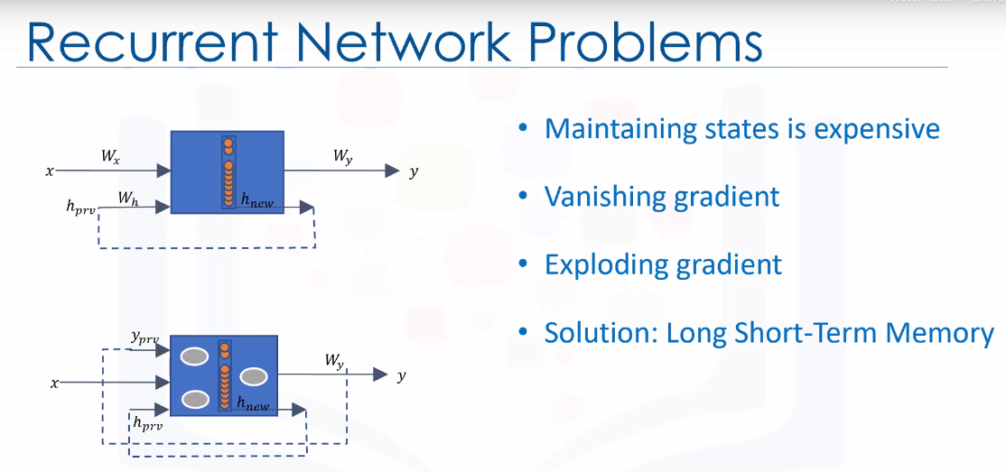

Slide 68
Recurrent Neural Network- 2 – The LSTM Unit
An LSTM unit in Recurrent Neural Networks is composed of four main elements:
The “memory cell”, and three logistic “gates”.
The “memory cell” is responsible for holding data.
The write, read, and forget gates, define the flow of data inside the LSTM.
The Write Gate is responsible for writing data into the memory cell.
The Read Gate reads data from the memory cell and sends that data back to the recurrent network.
And the Forget Gate maintains or deletes data from the information cell, or in other words, determines how much old information to forget.
By manipulating these gates, a Recurrent Network is able to remember what it needs in a sequence and simply forget what is no longer useful.

Slide 69
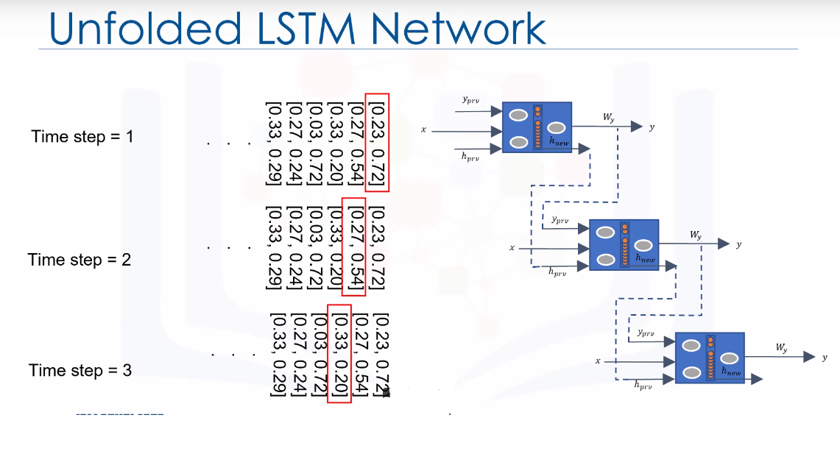
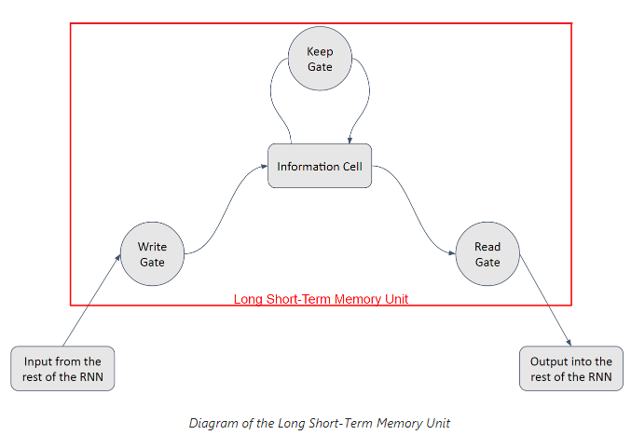
The way it works is simple: you have a linear unit, which is the information cell itself, surrounded by three logistic gates responsible for maintaining the data:
One gate is for inputting data into the information cell,
one is for outputting data from the input cell,
and the last one is to keep or forget data depending on the needs of the network

Slide 70
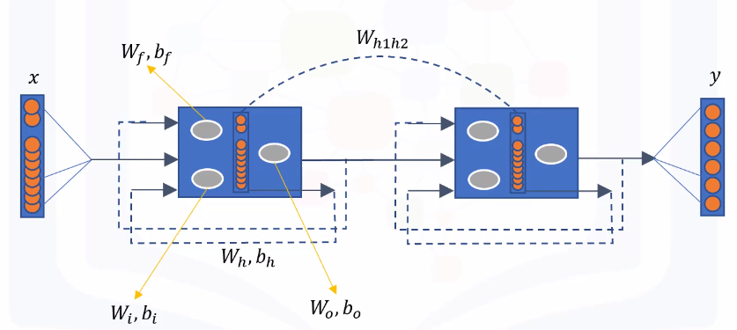
LSTM Training Process
The network learns to determine how much old information to forget through the forget gate.
So, the weights, denoted as Wf, and biases denoted as bf will be learned through the training procedure.
We also determine how much new information, called x, to incorporate through the input gate and its weights.
We also calculate the new cell state based on the current and the previous internal state, so the network has to learn its corresponding weights and biases.
Finally, we determine how much of our cell state we want to output an output gate.
Basically, the network is learning the weights and biases used in each gate, for each layer.

Slide 71
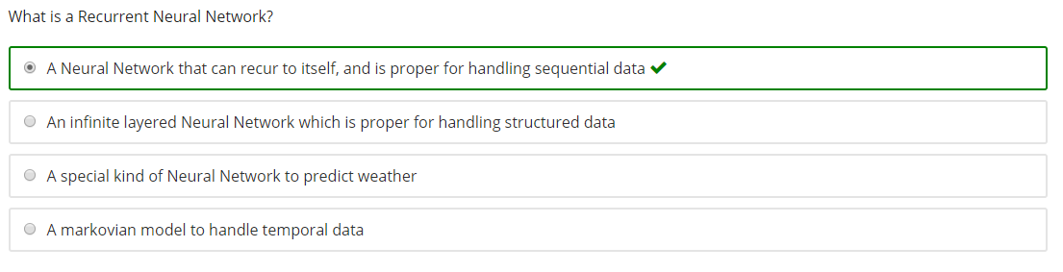
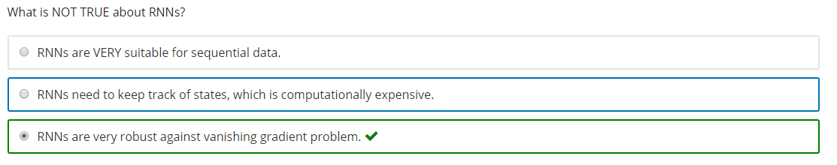

Slide 72
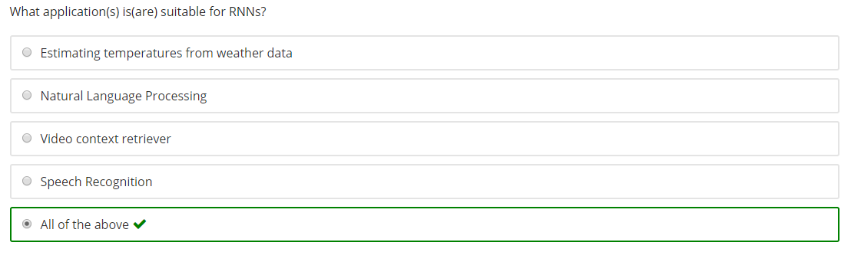


Slide 73


Slide 74

Recurrent Neural Network- 3
Language modelling is the process of assigning probabilities to sequences of words. So for example, a language model could analyze a sequence of words, and predict which word is most likely to follow.

Slide 75
Recurrent Neural Network- 4
Word Embeddings, is a way of representing sentence structures or words as .n-dimensional vectors.
Basically, we will assign each word a randomly-initialized vector, and input those into the network to be processed. After a number of iterations, these vectors are expected to assume values that help the network to correctly predict what it needs to (example :the probable next word in the sentence).

Slide 76
Restricted Boltzmann Machine (RBM) - 1
RBM are shallow neural networks that only have two layers.
They are an unsupervised method used to find patterns in data by reconstructing the input.
The first layer of the RBM is called the visible layer, and the second layer is the hidden layer.
We say that they are "restricted" because neurons within the same layer are not connected.
Feeding the input data, the network learns its weights.
RBMs are used as the main block of another type of Deep Neural Network, which is called, Deep Belief Networks.

Slide 77

Restricted Boltzmann Machine (RBM) – 2 – Training Process
The learning process consists of several forward and backward passes, where the RBM tries to reconstruct the input data.
The weights of the neural net are adjusted in such a way that the RBM can find the relationships among input features, and then determines which features are relevant.
After training is complete, the net is able to reconstruct the input based on what it learned.

Slide 78
Restricted Boltzmann Machine (RBM) – 3– Training Process
The first step is the forward pass. In the forward pass, the input image is converted to binary values, and then, the vector input is fed into the network, where its values are multiplied by weights, and an overall bias, in each hidden unit.
Then, the result goes to an activation function, such as the sigmoid function, which represents the probability of turning each individual hidden-unit on, or in other words, the probability of the node activation.
Then, a sample is drawn from this probability distribution, and it finds which neurons may or may not activate. This means, it makes stochastic decisions about whether or not to transmit that hidden data.
The intuition behind the sampling, is that there are some random hidden variables, and by sampling from the hidden layer, you can reproduce sample variants encountered during training.
So, the forward pass translates the inputs into a set of binary values that get represented in the hidden layer.

Slide 79


Slide 80
Restricted Boltzmann Machine (RBM) – 4– Training Process
In the backward pass, the activated neurons in the hidden layer send the results back to the visible layer, where the input will be reconstructed.
During this step, the data that is passed backwards is also combined with the same weights and overall bias that were used in the forward pass.
So, once the information gets to the visible layer, it is in the shape of the probability distribution of the input values, given the hidden values. And sampling the distribution, the input is reconstructed.
So, the Backward pass is about making guesses about the probability distribution of the original input.

Slide 81


Slide 82
Restricted Boltzmann Machine (RBM) – 5– Training Process
Step 3 consists of assessing the quality of the reconstruction by comparing it to the original data.
The RBM then calculates the error and adjusts the weights and bias in order to minimize it.
That is, in each epoch, we compute the "error" as a sum of the squared difference between step 1 and the next step. These 3 steps are repeated until the error is deemed sufficiently low.

Slide 83


Slide 84


Slide 85
Restricted Boltzmann Machine (RBM) – 6
RBMs learn from the data, they actually encode their own structure.
This is why they’re grouped into a larger family of models known as the Autoencoders.
However, Restricted Boltzmann Machines differ from Autoencoders in that they use a stochastic approach, rather than a deterministic approach.

Slide 86



Slide 87



Slide 88


Slide 89
Why are RBMs important?
It can automatically extract meaningful features from a given input.
How does it work?
RBM is a 2 layer neural network. Simply, RBM takes the inputs and translates those into a set of binary values that represents them in the hidden layer. Then, these numbers can be translated back to reconstruct the inputs. Through several forward and backward passes, the RBM will be trained, and a trained RBM can reveal which features are the most important ones when detecting patterns.
What are the applications of RBM?
RBM is useful for Collaborative Filtering, dimensionality reduction, classification, regression, feature learning, topic modeling and even Deep Belief Networks.

Slide 90

Autoencoders
An autoencoder is a type of unsupervised learning algorithm that will find patterns in a dataset by detecting key features.
It is a type of neural net that analyzes all of the images in your dataset and extracts some useful features automatically in such a way that it can distinguish images using those features.
An autoencoder neural network is supposed to represent the images in a dataset with a low dimension feature set. For example, it extracts the most important features of faces, for an arbitrary task such as face recognition.
Also, it is supposed to do it in an unsupervised manner, that is, “feature extraction” without provided labels for images.
The main goal of Autoencoders is to take unlabeled inputs, encode them, and then try to reconstruct them afterwards, based on the most valuable features identified in the data.

Slide 91

Autoencoders vs RBM
Also, Autoencoders differ from Restricted Boltzmann Machines because they use a deterministic approach, rather than a stochastic approach.

Slide 92


Slide 93


